Slide 1
UNIT 1 : Logic and Calculus

Slide 2
Propositional logic
The symbols of propositional calculus are the propositional symbols:
P, Q, R, S, …
the truth symbols:
true, false
and connectives:
∧, ∨, ¬, →, ≡

Slide 3
Propositional Calculus Sentences
Every propositional symbol and truth symbol is a sentence.
Examples: true, P, Q, R.
The negation of a sentence is a sentence.
Examples: ¬P, ¬ false.
The conjunction, or and, of two sentences is a sentence.
Example: P ∧ ¬P

Slide 4
Propositional Calculus Sentences (cont’d)
The disjunction, or or, of two sentences is a sentence.
Example: P ∨ ¬P
The implication of one sentence from another is a sentence.
Example: P → Q
The equivalence of two sentences is a sentence.
Example: P ∨ Q ≡ R
Legal sentences are also called well-formed formulas or WFFs.

Slide 5
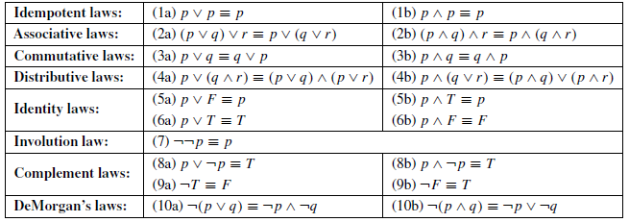
For propositional expressions P, Q, R

Slide 6
Truth table for the operator ∧

Slide 7
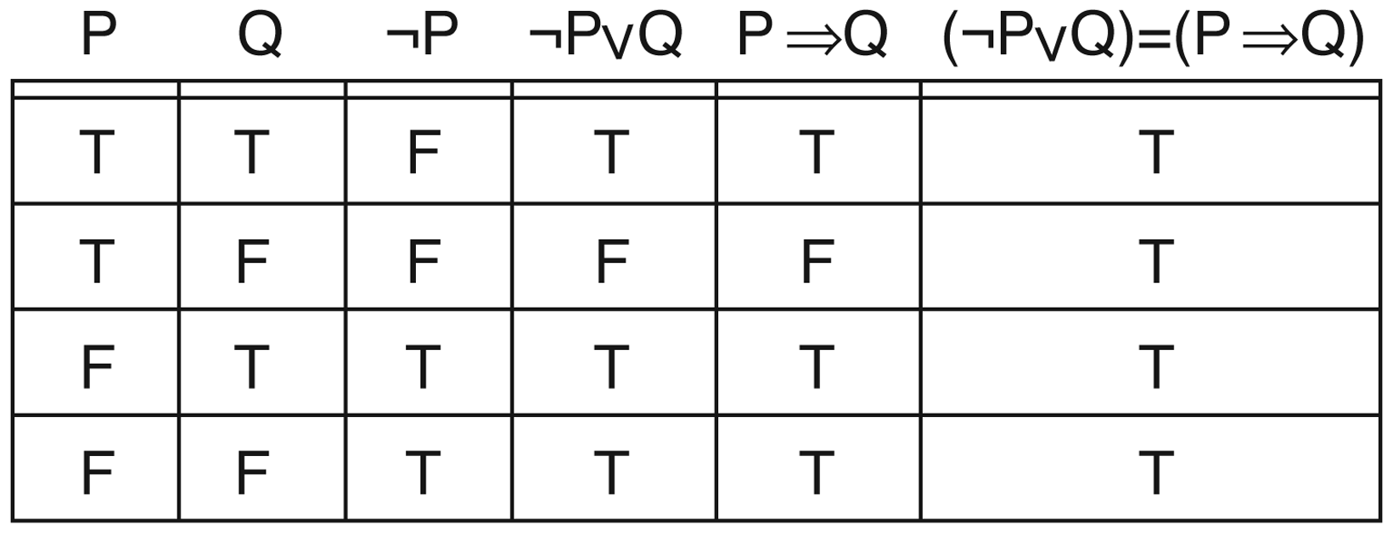
Truth table demonstrating the equivalence of ¬P∨Q and P→Q

Slide 8
Prove using a truth table

Slide 9
Predicate calculus sentences
Every atomic sentence is a sentence.
If s is a sentence, then so is its negation, ¬s.
If s₁ and s₂ are sentences, then so is their
Conjunction, s₁ ∧ s₂ .
Disjunction, s₁ ∨ s₂ .
Implication, s₁ → s₂ .
Equivalence, s₁ ≡ s₂ .

Slide 10
Predicate calculus sentences (cont’d)
If X is a variable and s is a sentence, then so are
6. ∀X s.
7. ∃X s.
Remember that logic sentences evaluate to true or false, therefore only such objects are atomic sentences. Functions are not atomic sentences.

Slide 11
First-order predicate calculus
First-order predicate calculus allows quantified variables to refer to objects in the domain of discourse and not to predicates or functions.
John likes to eat everything.
∀X food(X) → likes (john,X)
John likes at least one dish Jane likes.
∃F food(F) ∧ likes (jane, F) ∧ likes (john, F)
John “does” everything Jane does.
∀P P(Jane) → P(john) This is not first-order.

Slide 12
Order of quantifiers matters
Everybody likes some food.
There is a food that everyone likes.
Whenever someone likes at least one spicy dish, they’re happy.

Slide 13
Order of quantifiers matters
Everybody likes some food.
∀X ∃F food(F) ∧ likes (X,F)
There is a food that everyone likes.
∃F ∀X food(F) ∧ likes (X,F)
Whenever someone eats a spicy dish, they’re happy.
∀X ∃F food(F) ∧ spicy(F) ∧ eats (X,F) →
happy(X)

Slide 14
Prove That

Slide 15
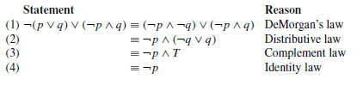
Solution

